Slide 1

PHP Basic Syntax
Data types, Variables, Expressions, Conditionals, Loops, Strings
SoftUni Team
Technical Trainers
Software University
http://softuni.bg

Slide 2
Table of Contents
What is PHP?
Declaring and Using Variables
Data Types in PHP
Integer, Floating-Point, Boolean, String
String Manipulation
Conditional Statements
If, if else, switch case
Loops
While, Do while, For

Slide 3
Have a Question?
sli.do
#php-web

Slide 4

Web Technology

Slide 5



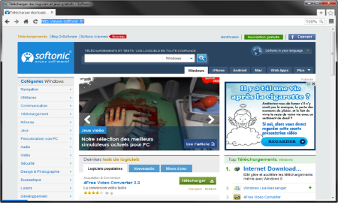





Web Server Work Model
Web Client
Web Server
Technology - PHP
Request
Response
Web Resources
Database
HTML, PDF, JPG…

Slide 6

Development Environment
XAMPP

Slide 7
What is XAMPP?
XAMPP (/ˈzæmp/ or /ˈɛks.æmp/)
PHP + MySQL + Apache + tools
Free, open source software package
Runs on Windows, Linux and Mac OS X
Apache Web server + OpenSSL
MySQL database + phpMyAdmin
Scripting languages: PHP and Perl
Admin panel for simplified administration

Slide 8
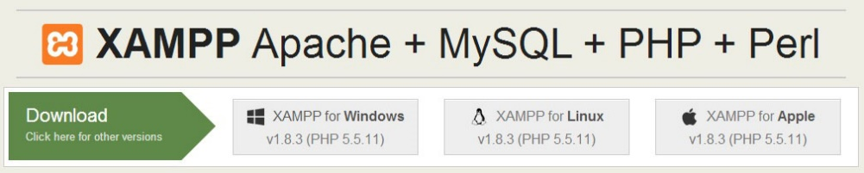
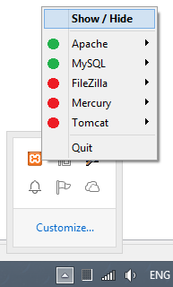
XAMPP
Downloading XAMPP:
https://www.apachefriends.org/download.html
Installing XAMPP for Windows:
Download the installer (run it as administrator)
Usual Windows installation: Next -> Next -> Finish
Running XAMPP
XAMPP start as a tray icon

Slide 9
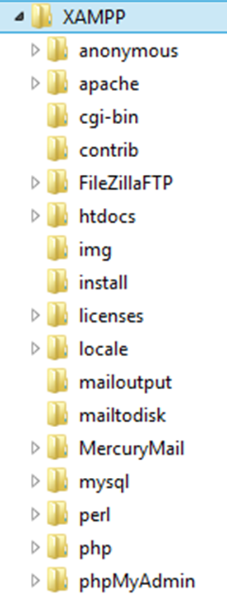
XAMPP Directories
Location of public HTML files (document root)
./htdocs
Location of Apache Web server
./apache
Location of PHP interpreter
./php
Location of MySQL database server
./mysql

Slide 10
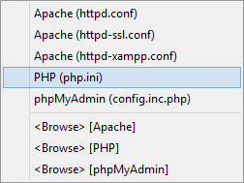

XAMPP Configuration Files
Apache configuration file (httpd.conf)
.\apache\conf\httpd.conf
PHP configuration file (php.ini):
.\apache\bin\php.ini
MySQL configuration file (my.cnf):
.\mysql\bin\my.cnf

Slide 11



PHP IDEs
PHP Storm, NetBeans, Eclipse

Slide 12
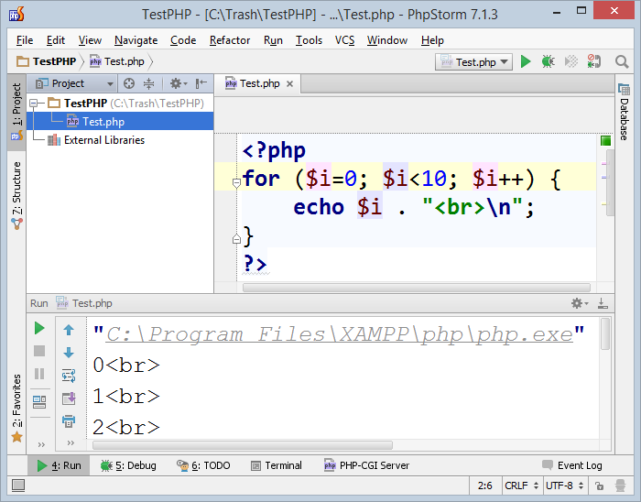
PHP Storm
PHP Storm
Powerful PHP IDE
By JetBrains, paid product
Built-in Web server for simplified configuration
Easy to install and configure
Debugger (Xdebug support)
http://jetbrains.com/phpstorm/

Slide 13
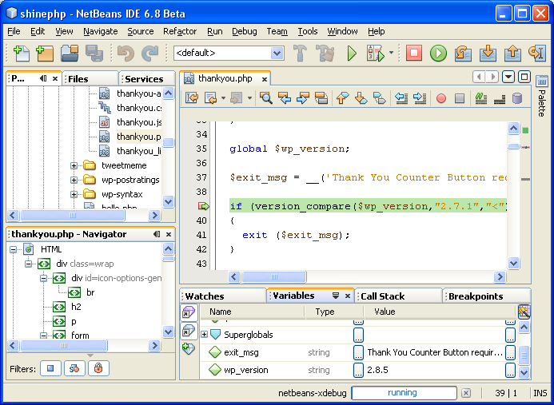
NetBeans for PHP
The NetBeans IDE fully supports PHP
Free, open-source IDE
PHP code editor
Debugger (through Xdebug)
Server integration
Frameworks support:
Symfony, Zend

Slide 14
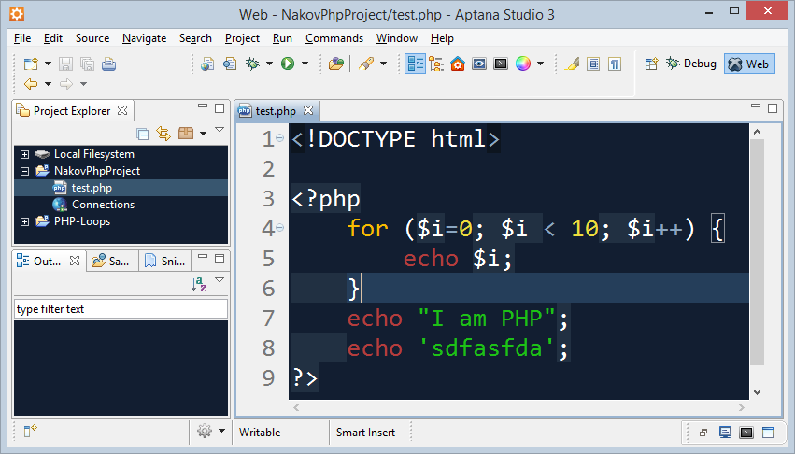
Eclipse PDT / Aptana Studio
The Eclipse platform provides solid PHP development support
PDT – PHP Development Tools
Write PHP code, Web server integration, debugging (Xdebug)
Free, open-source: http://www.eclipse.org/pdt/
Aptana Studio
Eclipse-based IDE for PHP, Ruby, Python
Supports also HTML, CSS, JavaScript
Open-source: http://www.aptana.com

Slide 15

What is PHP?

Slide 16
What is PHP?
PHP (PHP Hypertext Preprocessor)
PHP is server-side scripting language for building dynamic Web sites
In order to run our code, we need to tell our IDE that it's PHP code by using the <?php tag before our block of code
Php tag
<?php
echo "Hello, PHP!";
Code

Slide 17
Mixing PHP and HTML
PHP is designed to mix HTML and PHP code:
This is similar to writing echo "Hello John!";
Very useful for long texts
<?php $name = "John"; ?>
<?php if ($name == "John") { ?>
<p>Hello John!</p>
<?php } else { ?>
<p>You are not John.</p>
<?php } ?>

Slide 18

Declaring and Using Variables
p
q
i

Slide 19
What Is a Variable?
A variable is a:
Placeholder of information that can be changed at run-time
A piece of computer memory holding some value
Variables allow you to:
Store information
Retrieve the stored information
Change the stored information
p
q
i

Slide 20

Variable Characteristics
A variable has:
Name
Type (of stored data)
Value
Example:
Name: $counter
Type: integer
Value: 5
$counter = 5;

Slide 21

Data Types in PHP

Slide 22
What Is a Data Type?
A data type:
Is a domain of values of similar characteristics
Defines the type of information stored in the computer memory (in a variable)
PHP supports eight types:
Scalar: Boolean, Integer, Floating point, String
NULL
PHP is a dynamically typed language

Slide 23
PHP Data Types
PHP is a dynamically typed language
The variable types are not explicitly defined
The type of a variable can be changed at runtime
Variables in PHP are declared with the symbol $
$count = 5; // variable holds an integer value
$count = 'hello'; // the same variable now holds a string
$name = 'Svetlin Nakov'; // variable holds a string
$mark = 5.25; // mark holds a floating-point number
echo gettype($count); // integer
var_dump($count); // int 5

Slide 24

Integer Numbers
Integer types represent whole numbers
The size of an integer is platform-dependent
32-bit: -2147483647 to 2147483647
64-bit: -9223372036854775807 to 9223372036854775807
Note: some 64-bit builds have used 32-bit integers, particularly older Windows builds of PHP
Too large values for integer type are automatically turned into a floating-point number with exponent
$maxInteger = 9223372036854775807;
echo gettype($maxInteger); // integer
$maxInteger += 1;
echo gettype($maxInteger); // double

Slide 25

Floating-Point Numbers
Floating-point types represent real numbers, e.g. 5.63
In PHP the floating-point numbers are 64-bit
Stored in the IEEE 754 format
Have range from -1.79e+308 to 1.79e+308
Have precision of roughly 14 digits
Can behave abnormally in the calculations
E.g. 0.1 + 0.2 = 0.30000000000000004

Slide 26
Numbers Conversion
Convert to float number
Convert to integer number
Convert string to integer
$variable = 5;
$floatVar = floatval($variable);
// Or:
$floatVar = (float)$variable;
$variable = 5.24245;
$varInt = intval($variable);
// Or:
$varInt = (int)$variable;
$num = "3.14";
$int = (int)$num;
$float = (float)$num;

Slide 27
The Boolean Data Type
Has two possible values: true and false
Values are case-insensitive (True, true, TRUE & False, false, FALSE)
Is useful in logical expressions
Returns "1" or "null"
Example of Boolean variables:
echo(true); // 1
echo(false); // (nothing)
var_dump(true); // bool(true)
var_dump(false); // bool(false)

Slide 28
The String Data Type
The string data type represents a sequence of characters
Strings are enclosed in quotes:
Best practices suggest using the most appropriate quotes
Strings can be concatenated (joined together)
Using the . (dot) operator
$string = 'Welcome to PHP';
$string = "'Welcome to PHP'";
$name = 'Soft' . ' ' . 'Uni'; // Soft Uni

Slide 29
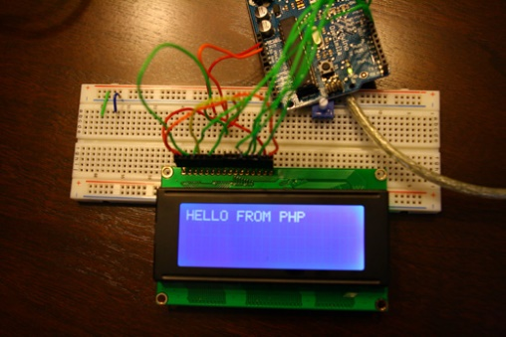
Variable Interpolation
Single-quoted strings do not interpolate variables:
Double-quoted string interpolate variables:
Curly braces ensures the correct variable is interpolated – best
$name = 'Fred';
echo 'Hello, $name'; // Hello, $name
$who = 'Svetlin';
$where = 'here';
echo "$who was $where"; // Svetlin was here
$n = 12;
echo "You are the {$n}th person";

Slide 30
Null Value
In PHP there is a special value NULL
Undefined means that a variable is declared but not initialized
Null means that an object exists and is empty (has no value)
All variables can be reset to null with unset()
<?php $variable; // variable is undefined
$variable = 4; // variable has value 4
$variable = NULL; // variable has no value
unset($variable); // variable is undefined
?>

Slide 31
Checking the Type of a Variable
The variable type can be checked with gettype()
Or just print it with var_dump()
Great for checking the type and value of a given variable in the code
$boolVariable = true;
gettype($boolVariable); // boolean
$intVariable = 123;
gettype($intVariable); // integer
$stringVariable = "SoftUni";
gettype($stringVariable); // string
$b = true;
var_dump($b); // boolean(true)
$i = 123;
var_dump($i); // integer(123)
$s = "PHP";
var_dump($s); // string("PHP")

Slide 32
Expressions
Expressions are:
Sequences of operators, literals and variables that are evaluated to some value
Examples:
$r = (150 - 20) / 2 + 5; // r = 70
// Expression for calculation of circle area
$surface = pi() * $r * $r;
// Expression for calculation of circle perimeter
$perimeter = 2 * pi() * $r;

Slide 33
H
e
l
l
o
Strings in PHP
What is String?

Slide 34
Strings
Strings hold a sequence of Unicode characters
Single quoted string
Double quoted string
$lang = 'PHP';
echo 'I love $lang\n'; // I love $lang\n
$str = 'I\'m a student at "Software University"';
echo $str; // I'm a student at "Software University"
$str = "I'm a student at \"Software University\"";
echo $str; // I'm a student at "Software University"

Slide 35

String Manipulation
Comparing, Concatenating, Searching...

Slide 36
String Concatenation
In PHP there are two operators for combining strings:
Concatenation Operator
Concatenating Assignment Operator
$str = "I live in ";
$str .= "Sofia";
echo $str; // I live in Sofia
$str = "My hometown is ";
$town = "Varna";
echo $str . $town; // My hometown is Varna

Slide 37
Accessing Characters and Substrings
strpos($input, $find)
returns the index of the first occurrence of string in another
strstr($input, $find, [boolean])
finds the first occurrence of a string and returns everything before or after
$str = "To be or not be that is the question.";
echo strpos($str, "that"); // 16
echo strstr("This is madness!\n", "is ") ; // is madness!
echo strstr("This is madness!", " is", true); // This

Slide 38
Accessing Characters and Substrings (2)
substr($str, $position, $count)
extracts $count characters from the start or end of a string
$str[$i]
$str = "abcdef";
echo substr($str, 1) ."\n"; // bcdef
echo substr($str, -2) ."\n"; // ef
echo substr($str, 0, 3) ."\n"; // abc
php $str = "Apples";
echo $str[2]; // p

Slide 39
Counting Strings
strlen($str)
returns the length of the string
str_word_count($str)
returns the number of words in a text
echo strlen("Software University"); // 19
$countries = "Bulgaria, Brazil, Italy, USA, Germany";
echo str_word_count($countries); // 5

Slide 40
Accessing Character ASCII Values
ord($str[$i])
returns the ASCII value of the character
chr($value)
returns the character by ASCII value
$text = "Call me Banana-man!";
echo ord($text[8]); // 66
$letter = chr(109);
echo "ASCII number 109 is equivalent to $letter\n"
// ASCII number 109 is equivalent to m

Slide 41
String Replacing
str_replace($target, $replace, $str)
replaces all occurrences of the target with the replacement string
str_ireplace($target, $replace, $str)
case insensitive replacing
$email = "user@mail.com";
$newEmail = str_replace("user", "pesho", $email);
echo $newEmail; // pesho@mail.com
$text = "HaHAhaHAHhaha";
$iReplace = str_ireplace("A", "o", $text);
echo $iReplace; // HoHohoHoHhoho

Slide 42
Splitting Strings
str_split($str, $length)
splits each character into a string with a specified length and returns an array
explode($delimiter, $string)
$text = "Hello how are you?";
$arrSplit = str_split($text, 5);
var_export($arrSplit);
// array ( 0 => 'Hello', 1 => ' how ', 2 => 'are y', 3 => 'ou?', )
echo var_export(explode(" ", "Hello how are you?"));
// array ( 0 => 'Hello', 1 => 'how', 2 => 'are', 3 => 'you?', )

Slide 43
Case Changing
strtolower()
strtoupper()
$str[$i]
php $lang = "JavaScript";
echo strtolower($lang); // javascript
php $lang = "php";
echo strtoupper($lang); // PHP
$str = "Hello";
$str[1] = 'a';
echo $str; // Hallo

Slide 44
Other String Functions
strcmp($string1, $string2)
performs a case-sensitive comparison
trim($text)
Both strings are equal
echo strcmp("Hello, world!", "Hello, world!") // 0
echo strcmp("Hello, world!", "Hello") // 7
echo strcmp("Hello", "Hello, world!") // -7
String1 is longer than string2
String1 is shorter than string2
$boo = " \"it's wide in here\" ";
echo trim($boo); // "it's wide in here"

Slide 45

Live Exercises

Slide 46

Conditional Statements
IF
ELSE IF
ELSE
If, If-else, Switch-case

Slide 47
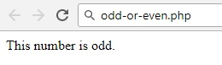
If and If-else
PHP implements the classic if / if-else statements
$number = 5;
if ($number % 2 == 0) {
echo "This number is even.";
} else {
echo "This number is odd.";
}

Slide 48
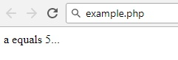
If and If-else (2)
PHP offers an alternative syntax for the if-statement:
$a = 5;
if ($a == 5):
echo "a equals 5";
echo "...";
elseif ($a == 6):
echo "a equals 6";
echo "!!!";
else:
echo "a is neither 5 nor 6";
endif;

Slide 49
Switch Case
Selects the case which matches the value of the switch expression and executes it
switch ($day) {
case 1: echo('Monday'); break;
case 2: echo('Tuesday'); break;
case 3: echo('Wednesday'); break;
case 4: echo('Thursday'); break;
case 5: echo('Friday'); break;
case 6: echo('Saturday'); break;
case 7: echo('Sunday'); break;
default: echo('Error!'); break;
}

Slide 50
Switch Case (2)
PHP offers an alternative syntax for the switch constructs:
$variable = 2;
switch ($variable):
case 1:
echo "<div>News</div>";
break;
case 2:
echo "<div>Forum</div>";
break;
endswitch;

Slide 51
Live Exercises

Slide 52

Loops
While, Do-while, For, Foreach

Slide 53
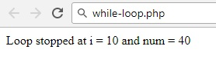
While Loop
While loops repeat a block of code if and as long as a certain condition is true:
$i = 0;
$num = 50;
while ($i < 10){
$num--;
$i++;
}
echo "Loop stopped at i= $i and num = $num";

Slide 54
Do-while Loop
Do-while loop executes a block of code at least once
It then continues to loop through the code as long as a certain condition is true
$i = 10;
do {
echo $i . " ";
$i--;
} while ($i > 0);
$i = -6;
do {
echo $i . " ";
$i--;
} while ($i > 0);
10 9 8 7 6 5 4 3 2 1
-6

Slide 55
For Loop
For loop executes a block of code a specified number of times
for($i=0; $i<=10; $i++){
echo $i . " ";
}
for($i=10; $i<=0; $i--){
echo $i . " ";
}
0 1 2 3 4 5 6 7 8 9 10
10 9 8 7 6 5 4 3 2 1 0

Slide 56
For-Loop – Alternative Syntax
Printing blocks of different colors:
<?php
for ($r=0, $g=0, $b=0; $r < 256; $r+=16, $g+=8, $b+=4) :
$color = "#" .
str_pad(dechex($r), 2, '0') .
str_pad(dechex($g), 2, '0') .
str_pad(dechex($b), 2, '0');
?>
<div style="width:400px;
background-color:<?= $color ?>"> <?= $color ?></div>
<?php endfor; ?>
converts decimal to hexadecimal

Slide 57
Problem: Colorful Numbers 1 … n
Print all the numbers from 1 to n
Return a string holding HTML list <ul><li>…</li></ul>
Display the odd lines in blue, even lines in green
<ul>
<li><span style='color:blue'>1</span></li>
<li><span style='color:green'>2</span></li>
<li><span style='color:blue'>3</span></li>
…
</ul>

Slide 58
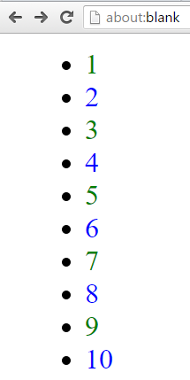
Solution: Colorful Numbers 1 … n
$n = 10;
$html = '<ul>';
for ($i = 1; $i <= $n; $i++) {
$color = 'blue';
if ($i % 2 != 0) {
$color = 'green';
}
$html .= " <li><span style='color: $color'>$i</span></li>";
}
$html .= '</ul>';

Slide 59
Live Exercises

Slide 60

Summary
…
…
…
PHP dynamic data types
number, string, boolean, null, others
Strings are sequences of characters.
Conditional statements execute some code if the condition is true
If, if-else, switch-case
Loops execute a block of code a specified number of times
While, do-while, for

Slide 61
https://softuni.bg/courses/php-basics

Slide 62













SoftUni Diamond Partners

Slide 63





SoftUni Organizational Partners

Slide 64




Trainings @ Software University (SoftUni)
Software University – High-Quality Education and Employment Opportunities
softuni.bg
Software University Foundation
http://softuni.foundation/
Software University @ Facebook
facebook.com/SoftwareUniversity
Software University Forums
forum.softuni.bg

Slide 65

License
This course (slides, examples, demos, videos, homework, etc.) is licensed under the "Creative Commons Attribution-NonCommercial-ShareAlike 4.0 International" license

